Slide 1
Problem session prep
Natalie Nelson, PhD, Biological and Agricultural Engineering
BAE 495/590: Applied Statistics for Env. & Ag. Data Analysis
January 19, 2018

Slide 2
Recap
Deterministic vs. stochastic processes
What is “uncertainty” and how does it relate to deterministic and stochastic processes?

Slide 3
Recap
What are important considerations to make when comparing samples collected from different populations?

Slide 4
Recap
What are two ways in which you can call a column in a dataframe?

Slide 5
Recap
What does the str( ) function do?

Slide 6
Exploratory Data Analysis (EDA)
Quick R vocab

Slide 7
Exploratory Data Analysis
Exploratory data analysis is the process of exploring your data, and it typically includes examining the structure and components of your dataset, the distributions of individual variables, and the relationships between two or more variables.
Data visualization is arguably the most important tool for exploratory data analysis because the information conveyed by graphical display can be very quickly absorbed and because it is generally easy to recognize patterns in a graphical display.
Peng and Matsui (2017), The Art of Data Science

Slide 8
EDA Checklist
Formulate your question
Read in your data
Check the packaging
Look at the top and bottom of your data
ABC: Always Be Checking your “n”s
Validate with at least one external data source
Make a plot
Try the easy solution first
Follow up
Pre-EDA
Perform iteratively throughout EDA
Post-EDA
Peng and Matsui (2017), The Art of Data Science

Slide 9
Some R vocab for today’s analysis
Function(arguments). For example:
mean(x)
# is used to comment out lines of code (meaning, R won’t read lines of code that begin with “#”). Use comments frequently in order to organize your code, as well as make notes to yourself. For example:
# Mean of variable x
mean(x)
To assign the output of a function to an object, use “<-”. Think of this is an arrow pointing the function to the object name. For example:
y <- mean(x) # assign the mean of x to an object named y
Peng and Matsui (2017), The Art of Data Science

Slide 10
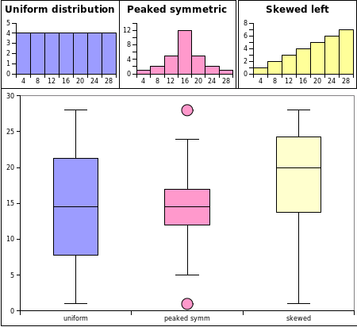
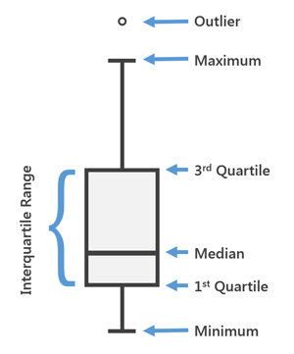
Boxplots
Image credit: ArcGIS Pro
Image credit: Helical IT Solutions

